Slide 1

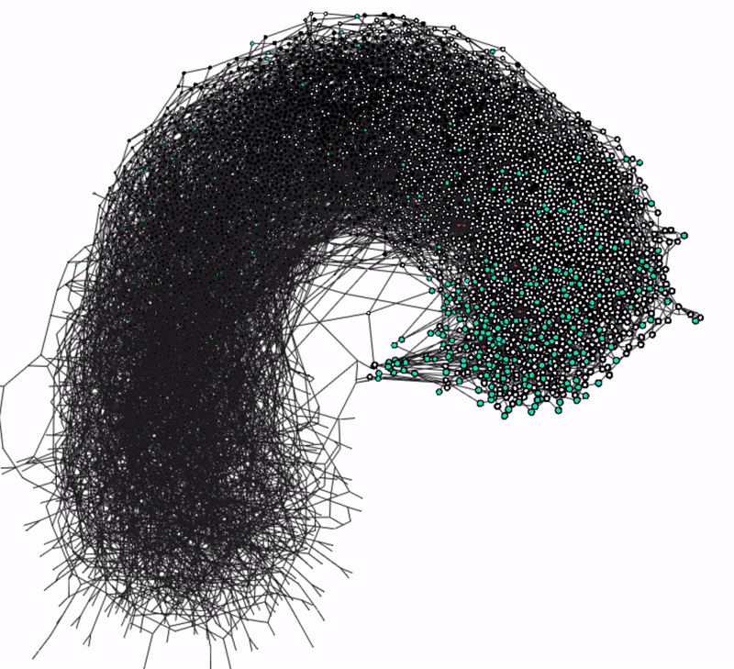

Project #STODT
South Tyrol Open Data Tangle
Open AI reference implementation that predicts pollution levels on routes, leveraging on the distribution of the Open Data Hub Südtirol - Alto Adige's datasets on the decentralized IoT communication protocol IOTA.
Mike MacKenzie - flickr
Attribution 2.0 Generic (CC BY 2.0)
Romantic representation of AI
Notes:
Resources for speaker:
https://www.sfscon.it/talks/open-data-the-iota-iot-protocol-and-our-stodt/
https://ecosystem.iota.org/projects/stodt-ex-codename-raspitin

Slide 2
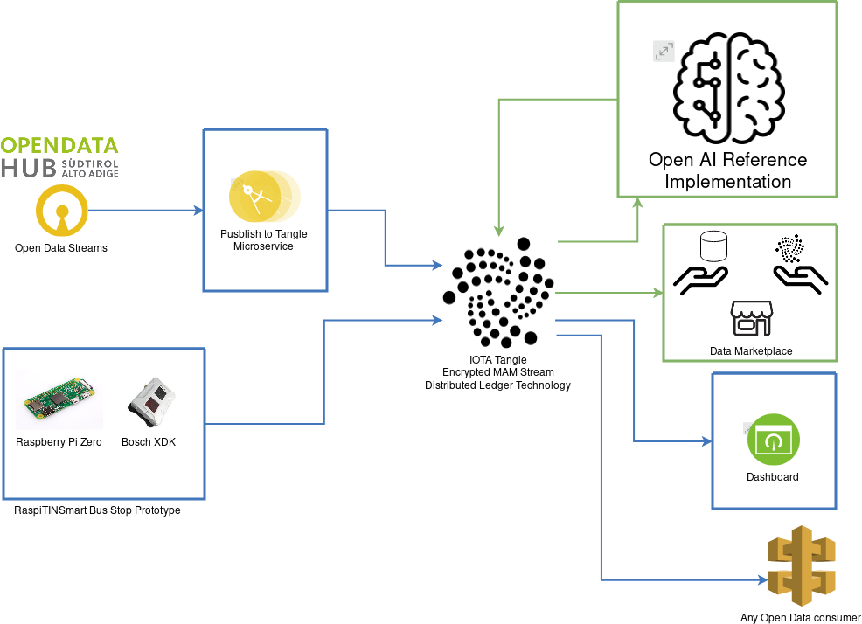
#STODT - Architecture

Slide 3
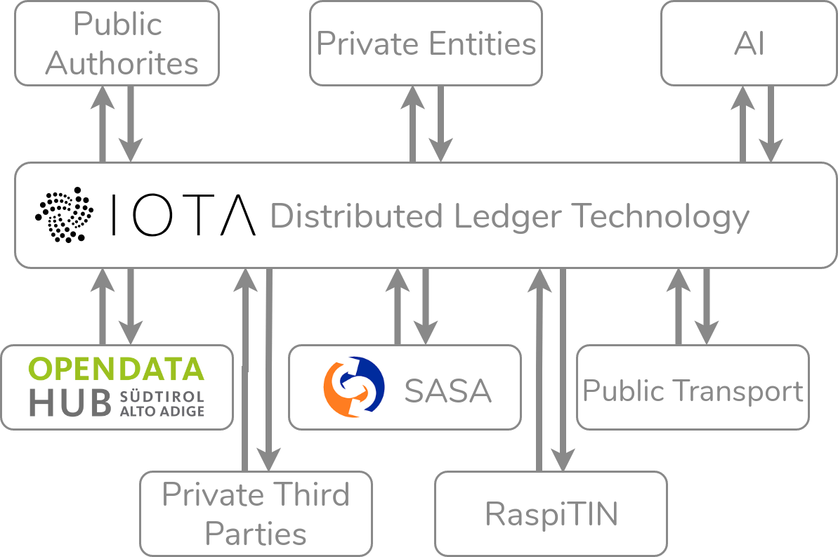
#STODT - IOTA Tangle DLT Advantage
Open Source
Permissionless
Data immutability
Decentralized
Feeless
Monetization

